Slide 1

Audience
Myself in the future
People who are curious
Developers

Slide 2
Not-Audience
Potential Investors
Users
People looking for entertainment
But feel free to watch anyway!

Slide 3


Sprint 1 Week 1
Boom v5.0 Demos
pagekey.io

Slide 4

Weekly Status
Feedback
Demo
Paste Gantt chart
Reflection
Challenges
Successes
Lessons Learned
Tech Debt
Future Plans

Slide 5

Feedback

Slide 6
Investor Concerns
BLUF: Expected returns, capital required
Value – How will it make things easier?
Describe Ideal Customer Profile (ICP)
How many people actually looking for this?
Describe strategy to capture customers
Marketing plans
Empirical results – research, benchmarks, etc.
Focus on what’s DONE, not what’s planned – show progress
Emphasis (will be) more on user growth than features

Slide 7
Presentation
Clarify audience
Have an agenda, show it at beginning
Emphasize why Boom unique
Dive into features / skills involved in language learning
Format distracting (too many slide changes)
More engaging production quality
Split into multiple videos

Slide 8
Other
Use sprints instead of weekly schedule (less pressure / rigidity)

Slide 9

Demo

Slide 11

Gantt Chart

Slide 12
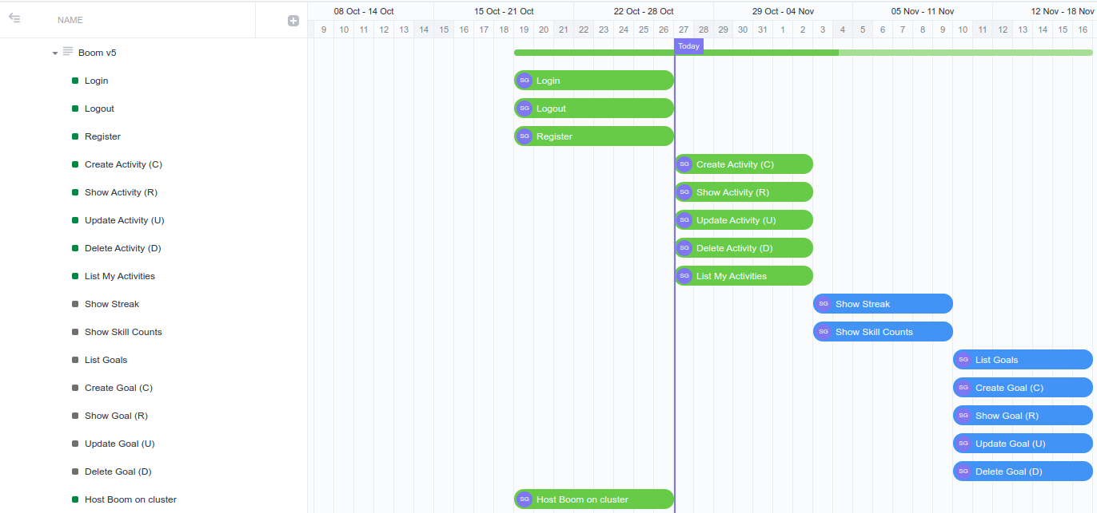

Slide 13

Reflection

Slide 14
Challenges
Working through technical challenges (see successes)

Slide 15

Successes
Kubernetes wins
Certs automated
Deploy automated
Helm charts added
Improve login/register flow
Completed first pass at all log features
Mongo -> Postgres

Slide 16

Lessons Learned
Helm is like Ikea Furniture – build your own
You pay for the simplicity of NoSQL
Be sure to AWAIT CALLS or errors will not bubble up!

Slide 17
New Tech Debt
Fix log edit on mobile (too long)
Validate edit log form (prevent empty skills, etc.)

Slide 18
Dev Plan
Sprint 1: MVP
Sprint 2: Find users, Measure UX Cleanup
Sprint 3: Add back Video Translator (first premium feature)
Sprint 4: ?

Slide 19

Long Term Plan
October:
Develop core features
Nov-Dec:
Find 5 test users, get feedback on core features
Add first Premium Feature
Add purchasing (buy buttons)
2024Q1:
Find users, improve product, repeat
Goal: 100 daily active users by 3/31/2024
Goal: 10 premium users by 3/31/2024

